Slide 1
LOTTERY SCHEDULING:
FLEXIBLE PROPORTIONAL-SHARE RESOURCE MANAGEMENT
Carl A. Waldspurger William E. Weihl
MIT LCS

Slide 2
Overview
Lottery scheduling
  Gives variable numbers of lottery tickets to processes
  Holds lotteries to decide which thread will get the CPU
Paper introduces currencies
  For allocating CPU among multiple threads of a single user

Slide 3
Traditional schedulers
Priority schemes:
  Priority assignments often ad hoc
  Schemes using decay-usage scheduling are poorly understood
“Fair share” schemes adjust priorities with a feedback loop to achieve fairness
  Only achieve long-term fairness

Slide 4
Lottery scheduling
Priority determined by the number of tickets each thread has:
  Priority is the relative percentage of all of the tickets whose owners compete for the resource
Scheduler picks winning ticket randomly, gives owner the resource

Slide 5
Example
Three threads
  A has 5 tickets
  B has 3 tickets
  C has 2 tickets
If all compete for the resource
  B has 30% chance of being selected
If only B and C compete
  B has 60% chance of being selected

Slide 6
Ticket properties
  Abstract:
  operate independently of machine details
  Relative:
  chances of winning the lottery depends on contention level
  Uniform:
  can be used for many different resources

Slide 7
Another advantage
Lottery scheduling is starvation-free
  Every ticket holder will finally get the resource

Slide 8
Fairness analysis (I)
Lottery scheduling is probabilistically fair
If a thread has a t tickets out of T
  Its probability of winning a lottery is p = t/T
  Its expected number of wins over n drawings is np
    Binomial distribution
    Variance σ² = np(1 – p)

Slide 9
Fairness analysis (II)
Coefficient of variation of number of wins σ/np = √((1-p)/np)
  Decreases with √n
Number of tries before winning the lottery follows a geometric distribution
As time passes, each thread ends receiving its share of the resource

Slide 10
Ticket transfers
Explicit transfers of tickets from one client to another
They an be used whenever a client blocks due to some dependency
  When a client waits for a reply from a server, it can temporarily transfer its tickets to the server
They eliminate priority inversions

Slide 11
Ticket inflation
Lets users create new tickets
  Like printing their own money
  Counterpart is ticket deflation
Normally disallowed except among mutually trusting clients
  Lets them to adjust their priorities dynamically without explicit communication

Slide 12
Ticket currencies (I)
Consider the case of a user managing multiple threads
  Want to let her favor some threads over others
  Without impacting the threads of other users

Slide 13
Ticket currencies (II)
Will let her create new tickets but will debase the individual values of all the tickets she owns
  Her tickets will be expressed in a new currency that will have a variable exchange rate with the base currency

Slide 14
Example (I)
Ann manages three threads
  A has 5 tickets
  B has 3 tickets
  C has 2 tickets
Ann creates 5 extra tickets and assigns them to process C
  Ann now has 15 tickets

Slide 15
Example (II)
These 15 tickets represent 15 units of a new currency whose exchange rate with the base currency is 10/15
The total value of Ann tickets expressed in the base currency is still equal to 10

Slide 16
Analogy
When coins represented specific amounts of gold and silver
  A king could create new money (inflation) by minting coins with a lesser amount of precious metal
  Worked well inside the kingdom
  Exchange rate of new coins with coins from other countries went down.

Slide 17
Compensation tickets (I)
I/O-bound threads are likely get less than their fair share of the CPU because they often block before their CPU quantum expires
Compensation tickets address this imbalance

Slide 18
Compensation tickets (II)
A client that consumes only a fraction f of its CPU quantum can be granted a compensation ticket
  Ticket inflates the value of all client tickets by 1/f until the client starts gets the CPU
    (Wording in the paper is much more abstract)

Slide 19
Example
CPU quantum is 100 ms
Client A releases the CPU after 20ms
  f = 0.2 or 1/5
Value of all tickets owned by A will be multiplied by 5 until A gets the CPU

Slide 20
Compensation tickets (III)
Compensation tickets
  Favor I/O-bound—and interactive—threads
  Helps them getting their fair share of the CPU

Slide 21
IMPLEMENTATION
On a MIPS-based DECstation running Mach 3 microkernel
  Time slice is 100ms
    Fairly large as scheme does not allow preemption
Requires
  A fast RNG
  A fast way to pick lottery winner

Slide 22
Picking the winner (I)
First idea:
  Assign to each client a range of consecutive lottery ticket numbers
  Create a list of clients
  Use RNG to generate a winning ticket number
  Search client list until we find the winner

Slide 23
Example
Three threads
  A has 5 tickets
  B has 3 tickets
  C has 2 tickets
List contains
  A (0-4)
  B (5-7)
  C (8-9)
Search time is O(n)
where n is list length

Slide 24
Picking the winner (II)
Better idea:
  For larger n
  "A tree of partial ticket sums, with clients at the leaves"

Slide 25
Example
4
≤
>
A
7
≤
>
B
C

Slide 26
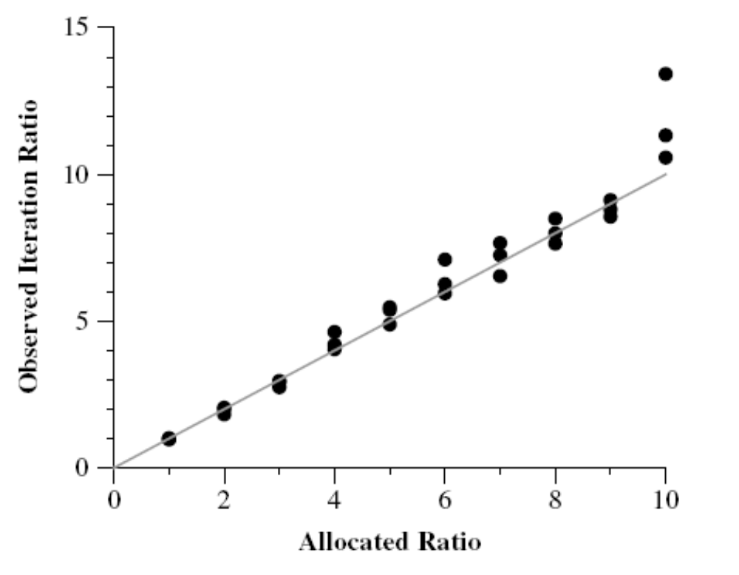
Long-term fairness (I)

Slide 27
Long-term fairness (II)
Allocation ratio is ratio of numbers of tickets allocated to the two tasks
Measurements made over a 60 s interval
Actual allocation fairly close to allocation ratio except for 10:1 ratio
  Resulted in an average ratio of 13.42
  Gets better over longer intervals

Slide 28
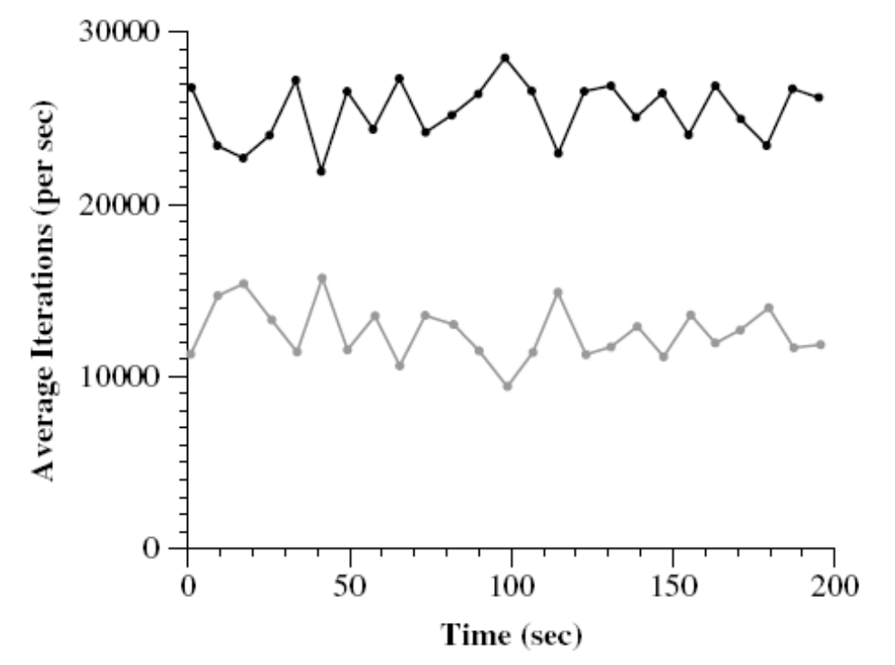
Short term fluctuations
For
2:1
ticket
alloc.
ratio

Slide 29
What the paper does not say
[A] straightforward implementation of lottery scheduling does not provide the responsiveness for a mixed interactive and CPU-bound workload offered by the decay usage priority scheduler of the FreeBSD operating system.
Moreover, standard lottery scheduling ignores kernel priorities used in the FreeBSD scheduler to reduce kernel lock contention.

Slide 30
What the paper does not say
Quotes are from:
  D. Petrou, J. W. Milford, and G. A. Gibson, Implementing Lottery Scheduling: Matching the Specializations in Traditional Schedulers, Proc. USENIX '99, Monterey CA, June 9-11, 1999.

